Slide 1

Name : Hafiz Mohsin Raza Registration No:2020-CS-81 Section:B Title:Story Detail video Department : Computer Science University of Engineering and Technology Lahore.

Slide 2
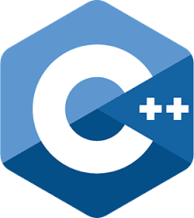
Programming Fundamental Introduction to C++ Programming
home
2

Slide 3
Flowchart
home
Graphical representation of an algorithm or a portion of algorithm
Drawn using certain special-purpose symbols connected by arrows called flow lines:
Start and End
Calculation
Input / output
Selection
3

Slide 4
Compute and print the average of three numbers
home
Input n1,n2,n3
S = n1+n2+n3 Average = s / 3
Output average
4

Slide 5
First C++ Program: Printing a Line of Text
home
// A first program in C++.
#include<iostream>
using namespace std;
//function main begins program execution
int main()
{
cout << "Hello World!\n";
return 0;
}
Hello World!
5

Slide 6
Example
home
int main(){
int X = 5 , Y = 7 , Z;
cout<< X++ <<endl;
cout<< ++X <<endl;
5
7
Z = X++ + Y;
cout <<X<<"\t"<<Y<<"\t"<<Z<<endl;
8
7
14
Z = ++X + Y;
cout <<X<<"\t"<<Y<<"\t"<<Z<<endl;
9
7
16
Z = X++ + Y++;
cout <<X<<"\t"<<Y<<"\t"<<Z<<endl;
10
8
16
}
6

Slide 7
Read three numbers and print the smallest, use nested if
home
int main(){ int a, b, c;
cout<<"Please Enter three numbers: "; cin>>a>>b>>c;
cout<<"Min = "; if (a < b)
if (a < c) else
cout<<a; cout<<c;
else
if (b < c) else
cout<<b; cout<<c;
}
Please Enter three numbers: 5 11
9
Min = 5
7

Slide 8
Generate 1200 random numbers between 1-6, then count the occurrence of each number
home
int main(){
int x, c1=0, c2=0, c3=0, c4=0, c5=0, c6=0;
for( int i = 1; i <= 1200 ; i++){
x = rand()%6 + 1;
if |  | (x | == | 1) c1++;
if |  | (x | == | 2) c2++;
if |  | (x | == | 3) c3++;
if |  | (x | == | 4) c4++;
if |  | (x | == | 5) c5++;
if |  | (x | == | 6) c6++;
 | }
 | cout<<1<<" : |  |  | "<<c1<<endl;
 | cout<<2<<" : |  |  | "<<c2<<endl;
 | cout<<3<<" : |  |  | "<<c3<<endl;
 | cout<<4<<" : |  |  | "<<c4<<endl;
 | cout<<5<<" : |  |  | "<<c5<<endl;
 | cout<<6<<" : |  |  | "<<c6<<endl;
}
1 : 190
2 : 188
3 : 214
4 : 207
5 : 200
6 : 201

Slide 9
Write a function that takes an integer and returns
true if it is a prime number and false otherwise
home
bool prime(int); int main(){
int x;
cout << "Enter a number please :";
cin >> x;
if (prime(x))
cout<< x <<" is a prime number\n"; else
cout << x <<" is not a prime number\n";
}
bool prime(int a){ bool p = true;
for(int i=2 ;i < a); i++)
if (a%i == 0){ p = false; break; }
return p;
}

Slide 10
Write a function that reads two numbers and another function to prints their sum
home
void read_number();
void print_sum(int,int);
int main(){
read_number();
}
void read_number(){
int A , B;
cout<<"Enter two numbers please "; cin>>A>>B;
print_sum(A , B);
}
void print_sum(int x,int y){ int s;
s = x + y;
cout<<x<<"+"<<y<<" = "<<s<<endl;
}

Slide 11
Sum of numbers from 1 to n
home
int sum(int);
void main() { int x;
cout<<"Enter end number: ";
cin>>x;
cout<<"Sum of the series = "<<sum(x)<<endl;
}
int sum(int n) {
if (n == 1)
return 1; else
return n + sum(n - 1);
}
Enter end number: 3 Sum of the series = 6

Slide 12
Write a program that inputs an array elements then prints the count of elements greater than 10
home
const int S = 10; int main() {
int A[S];
for(int i=0 ; i<S ; i++) {
cout << "Enter A[" << i << "]:";
cin >> A[i];
}
int count = 0;
for (int i = 0; i < S; i++) {
if (A[i] > 10)
count++;
}
cout<< "No of element > 10 = "<<count <<endl;
}

Slide 13
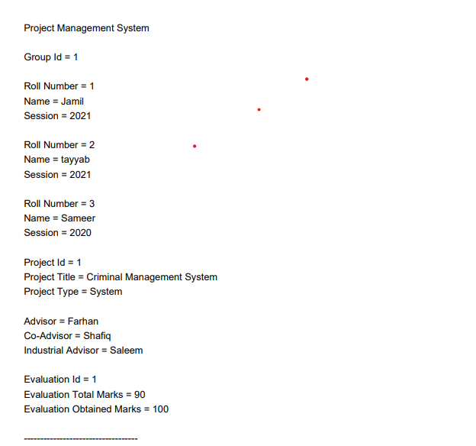
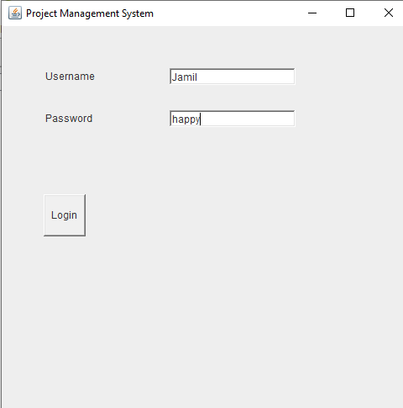
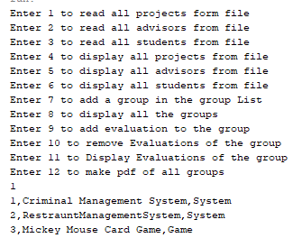
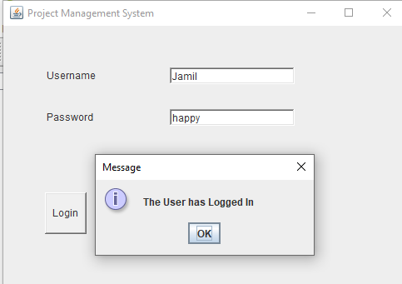
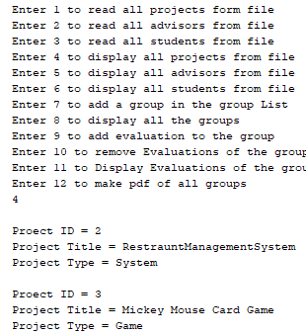
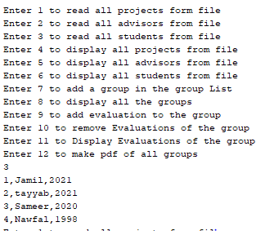
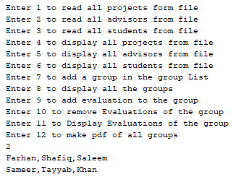
OOP Mid-term Project

Slide 14

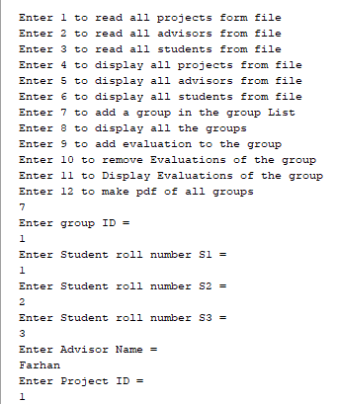
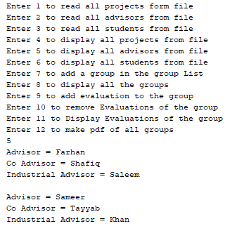
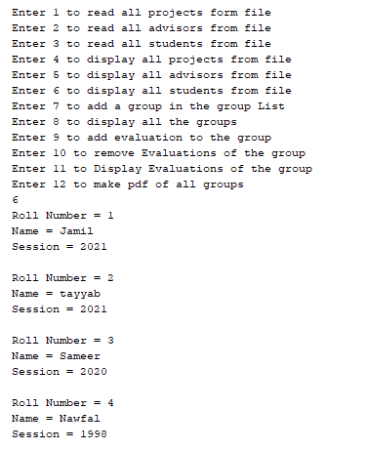
Object Oriented Programming Mid-term Project: Project Management System

Slide 15
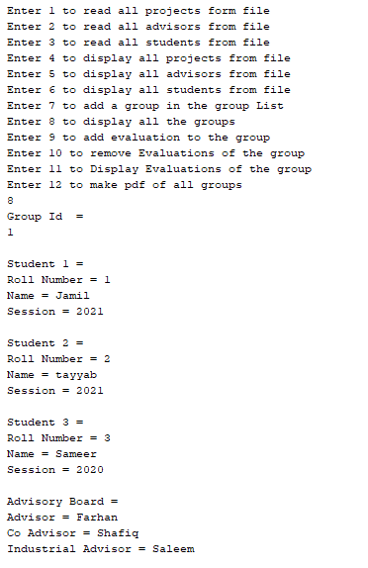

Slide 16
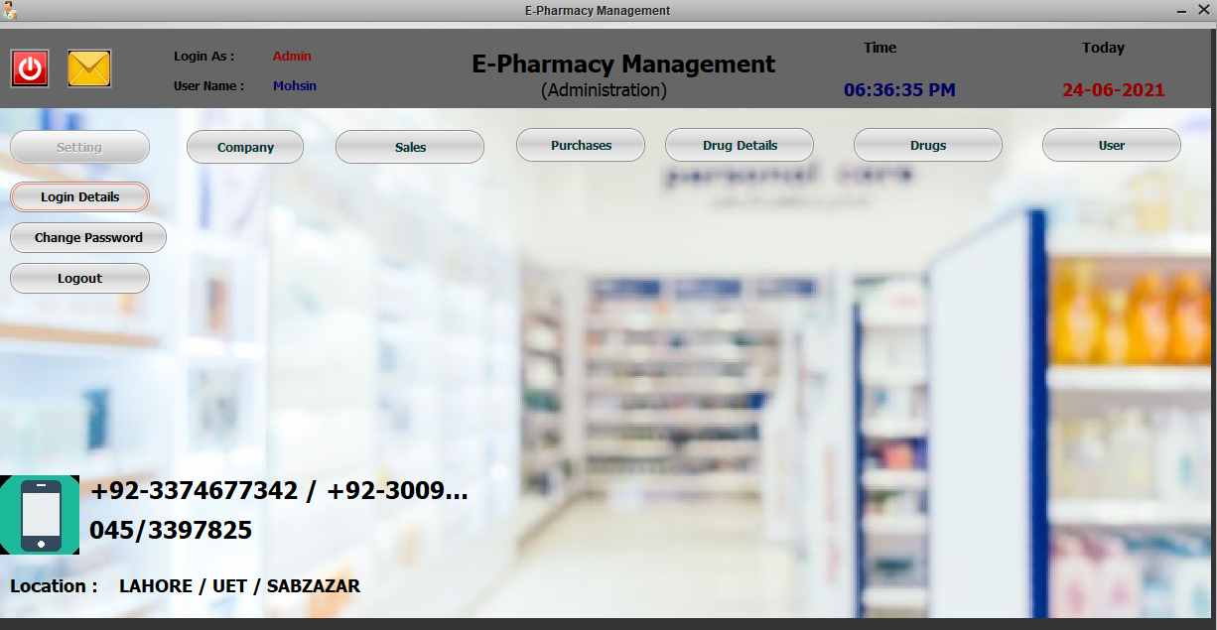
OOP Final Term Project E-Pharmacy Management System

Slide 17
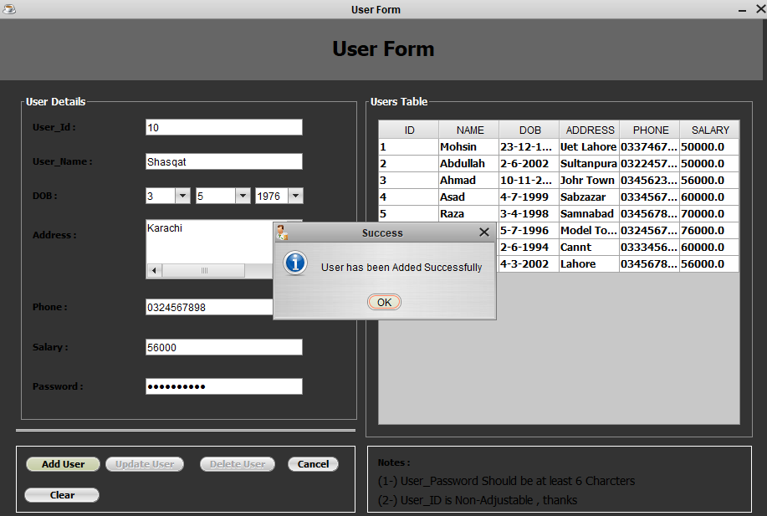
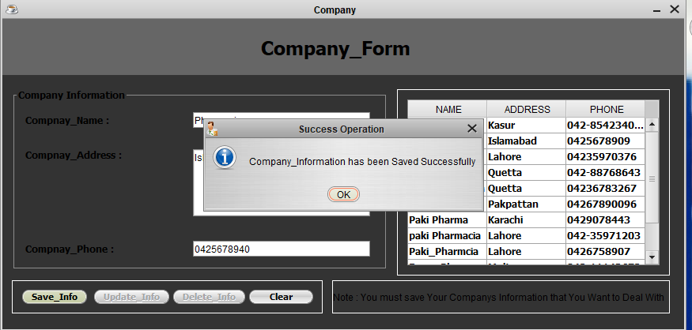
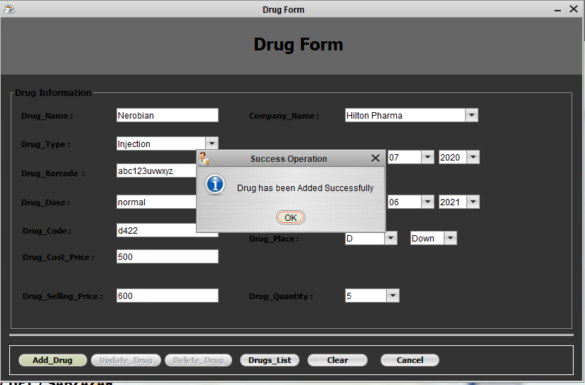
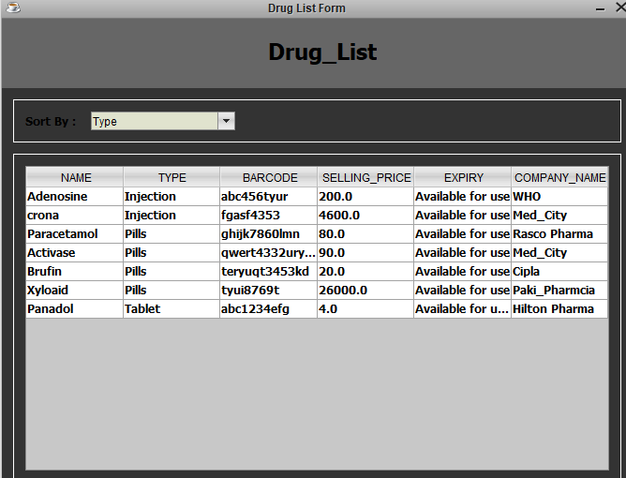
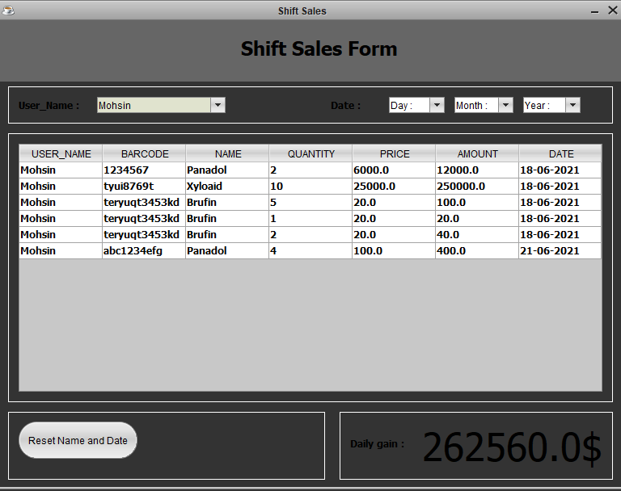
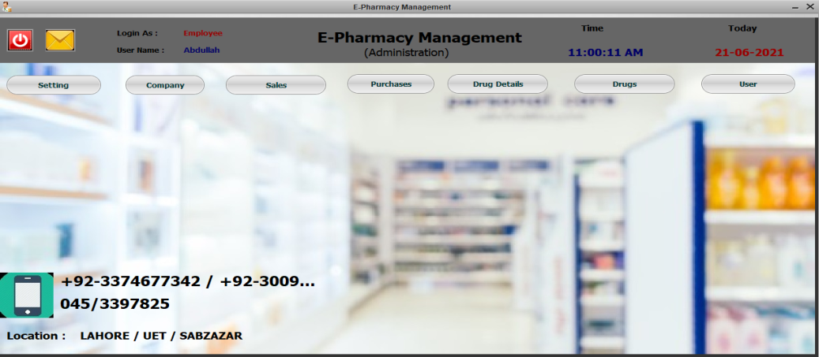
E-Pharmacy Management System

Slide 18

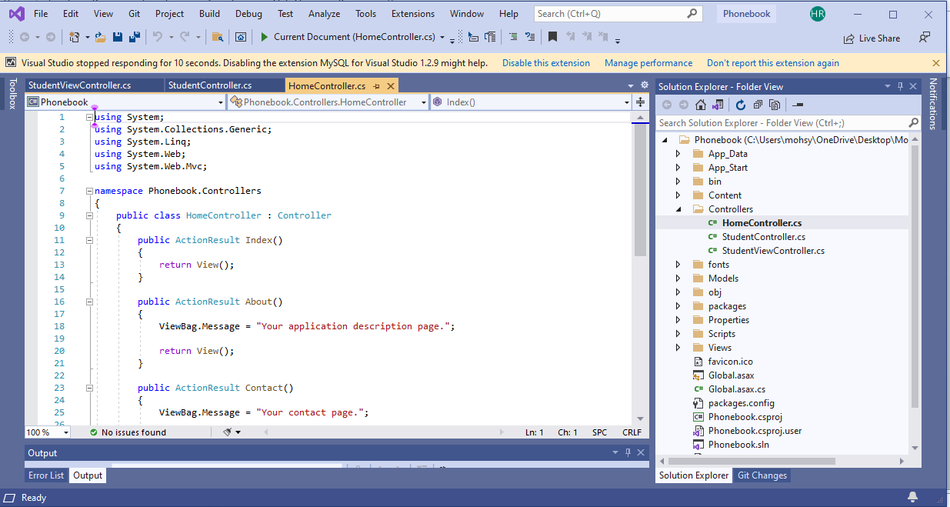
C-sharp(C#) to Website journey

Slide 19
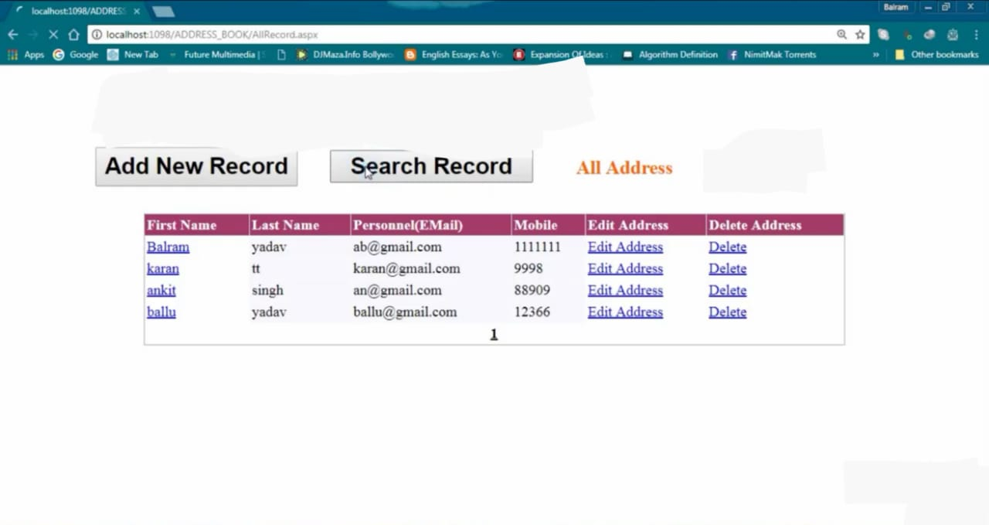
Simple Pnonebook Website Project

Slide 20
